Slide 1


Mzamomtsha JS Implementation
Tech Loyalties

Slide 2
JavaScript Implementation
Input Validation
Error Handling
Functionality Expansion
Pop-up

Slide 3
Benefits of JavaScript
Speed
Extended Functionality
Popularity
Simplicity

Slide 4
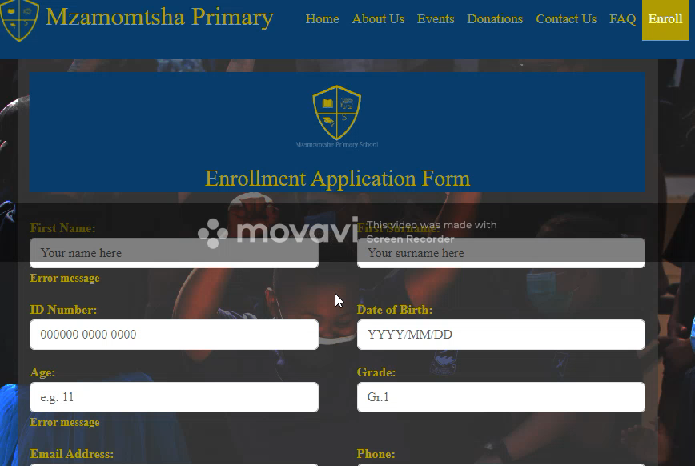
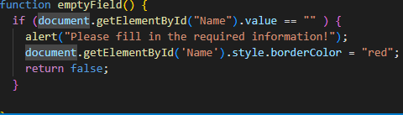
Input Validation

Slide 5
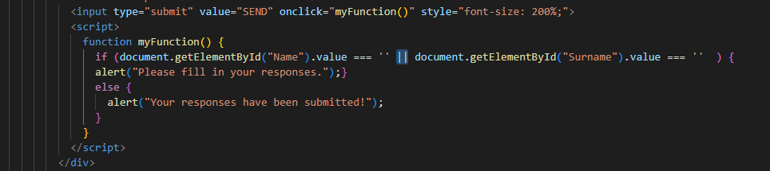
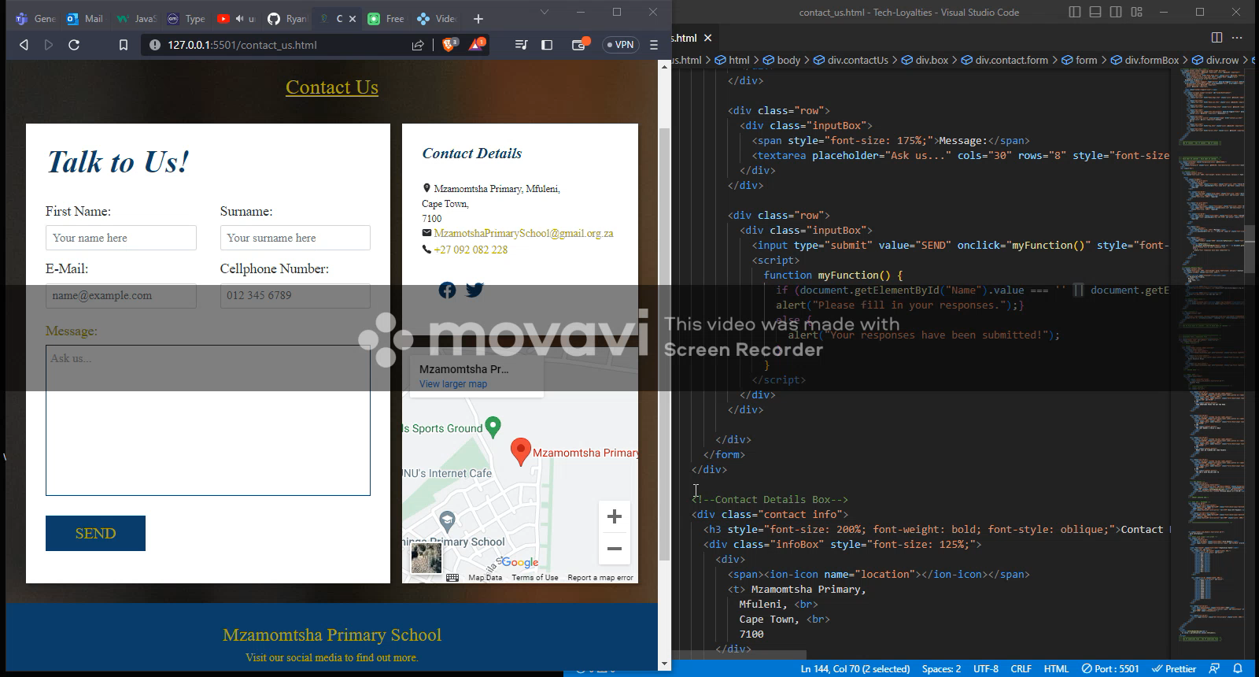
Error Handling

Slide 6
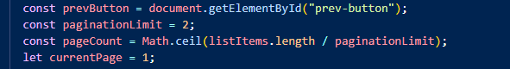
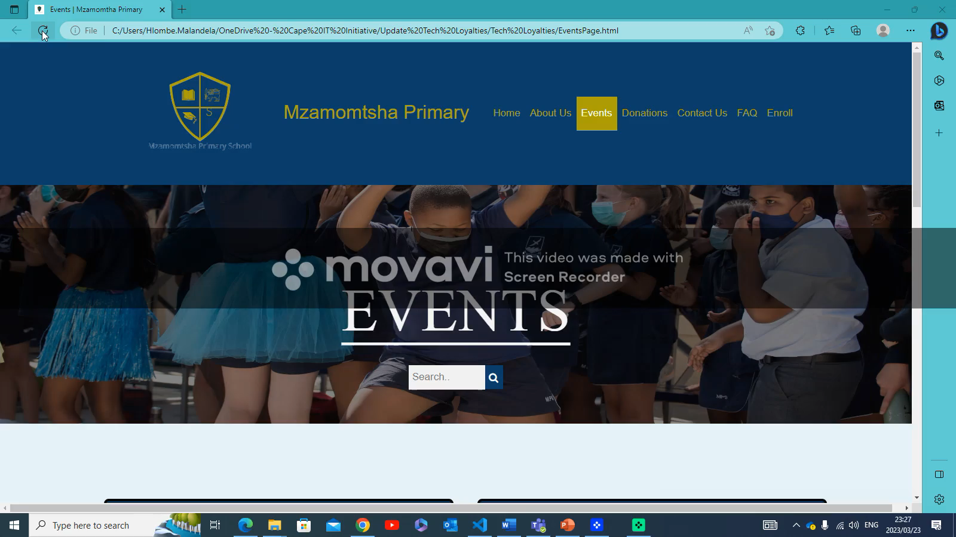
Functionality Expansion

Slide 7
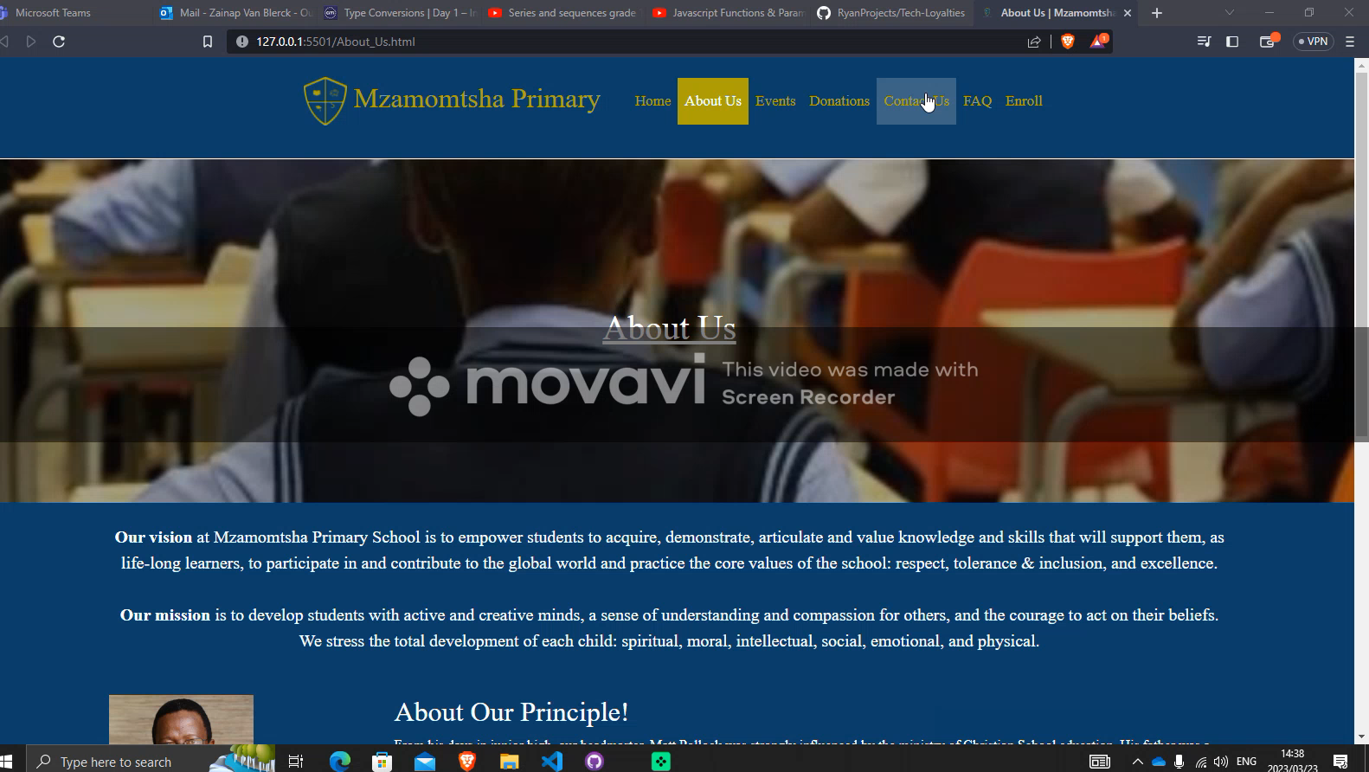
Pop Up!

Slide 8
Updated Website
Link: https://641d3f5e528b374a1bf6c7ca--kaleidoscopic-druid-21c908.netlify.app/

Slide 9
Conclusion
Faster Transition
Increase User Interactivity
Simple and Common

Slide 10
THANK YOU
ANY QUESTIONS?

